Slide 1

CUSTOMER CARE RESGISTRY
TECHNOLOGY ARCHITECTURE
TEAM DETAILS
Team No : PNT2022TMID06554
College Name : Erode Sengunthar Engineering College
Department : B.Tech Information Technology
Team Members: M. Anitha , M. Arunkumar , P. Santhosh , A. Venkatesan

Slide 2
Date | 03 October 2022
Team ID | PNT2022TMID06554
Project Name | Project – Customer Care Registry
Maximum Marks | 4 Marks

Slide 3
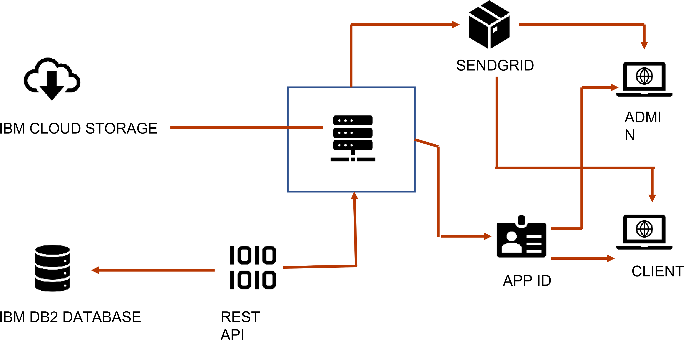
Project Design Phase II Technology Architecture

Slide 4
Technology Architecture
S.NO | COMPONENT | DESCRIPTION | TECHNOLOGY
1. | User Interface | How user interacts with application e.g. Web UI, Mobile App, Chatbot etc. | HTML, CSS, JavaScript / Angular Js / React Js etc.
2. | Application Logic-1 | Logic for a process in the application | Python
3. | Application Logic-2 | Logic for a process in the application | IBM Watson STT service
4. | Application Logic-3 | Logic for a process in the application | IBM Watson Assistant
5. | Database | Data Type, Configurations etc. | MySQL etc
6. | Cloud Database | Database Service on Cloud | IBM DB2, IBM Cloudant etc.
7. | File Storage | File storage requirements | IBM Block Storage or Other Storage Service or Local Filesystem
8. | Infrastructure (Server / Cloud) | Application Deployment on Local System / Cloud Local Server Configuration: Cloud Server Configuration : | Local, Cloud Foundry, Kubernetes, etc.

Slide 5
APPLICATION CHARACTERISTICS
S.N o | Characteristics | Description | Technology
1. | Open-Source Frameworks | List the open-source frameworks used | python flask
2. | Security Implementations | List all the security / access controls implemented, use of firewalls etc. | e.g., encryption, intrusion detection software, antivirus, firewalls
3. | Scalable Architecture | Justify the scalability of architecture (3 – tier, Microservices) | supports higher workloads without any fundamental changes to it.
4. | Availability | Justify the availability of application (e.g. use of load balancers, distributed servers etc.) | High availability enables your IT infrastructure to continue functioning even when some of its components fail.
5. | Performance | Design consideration for the performance of the application (number of requests per sec, use of Cache, use of CDN’s) etc. | Performance technology, therefore, is a field of practice that uses various tools, processes, and ideas in a scientific, systematic manner to improve the desired outcomes of individuals and organizations.

Slide 6
THANK YOU!!

